Slide 1
Hold on!
We are starting shortly
all our microphones are muted
ask your questions in Q&A, not in the Chat
use Chat for discussion, networking or applause

Slide 2
What's new in zabbix 6.0 LTS
all our microphones are muted
ask your questions in Q&A, not in the Chat
use Chat for discussion, networking or applause

Slide 3

Zabbix 6.0 LTS
Many of Zabbix 6.0 LTS features are focused on solving complex enterprise-level requirements.
Zabbix 6.0 focuses on:
Solving enterprise level security and redundancy requirements
Improving performance for large Zabbix instances
Providing additional value to different types of Zabbix users – DevOps and ITOps teams, Business process owner, Managers
Further extending Zabbix monitoring and data collection capabilities
Continued delivery of official integrations with 3rd party systems

Slide 4
Zabbix server High availability Cluster
01

Slide 5
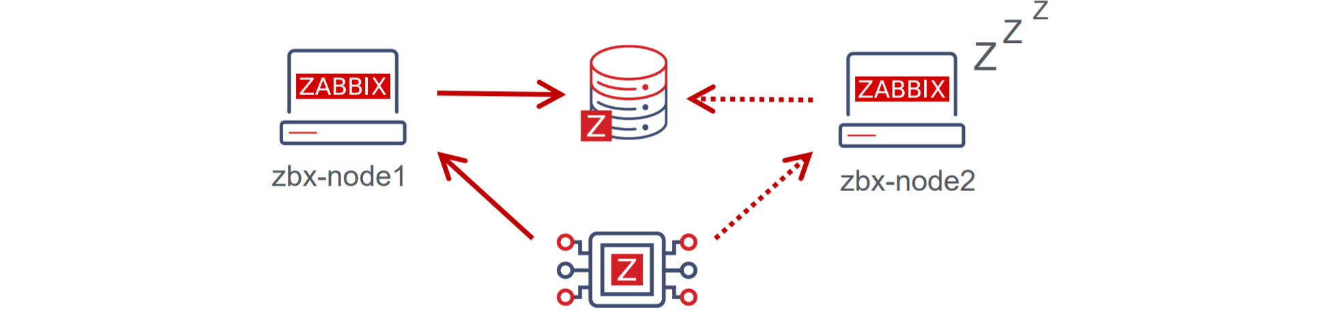
Zabbix Server high availability cluster
Zabbix administrators now have the ability to define Zabbix server HA clusters:
Define one or multiple redundant nodes
All nodes use the same database
Ability to define the failover delay period
The Zabbix server nodes send their heartbeat to the Zabbix database every 5 seconds

Slide 6
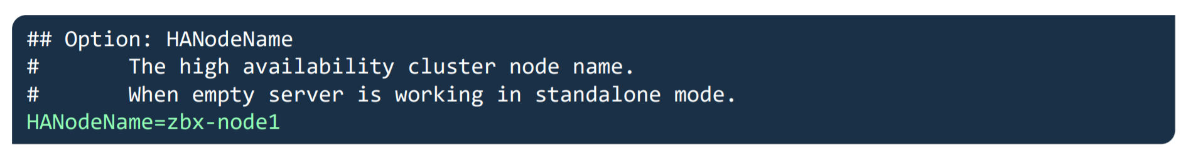
Zabbix Server high availability cluster
New parameter in Zabbix Server configuration file – HANodeName:
Empty by default
This parameter should contain an arbitrary name of the HA node
The parameter is mandatory for the node to start in the HA mode

Slide 7
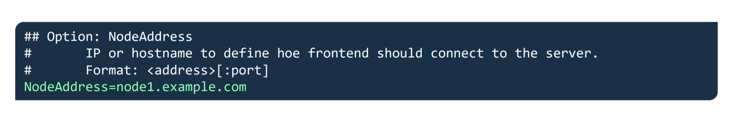
Zabbix Server high availability cluster
New parameter in Zabbix Server configuration file – NodeAddress:
Empty by default
This parameter should contain the address of the HA node
Let's the Zabbix frontend know the address of the currently active node

Slide 8
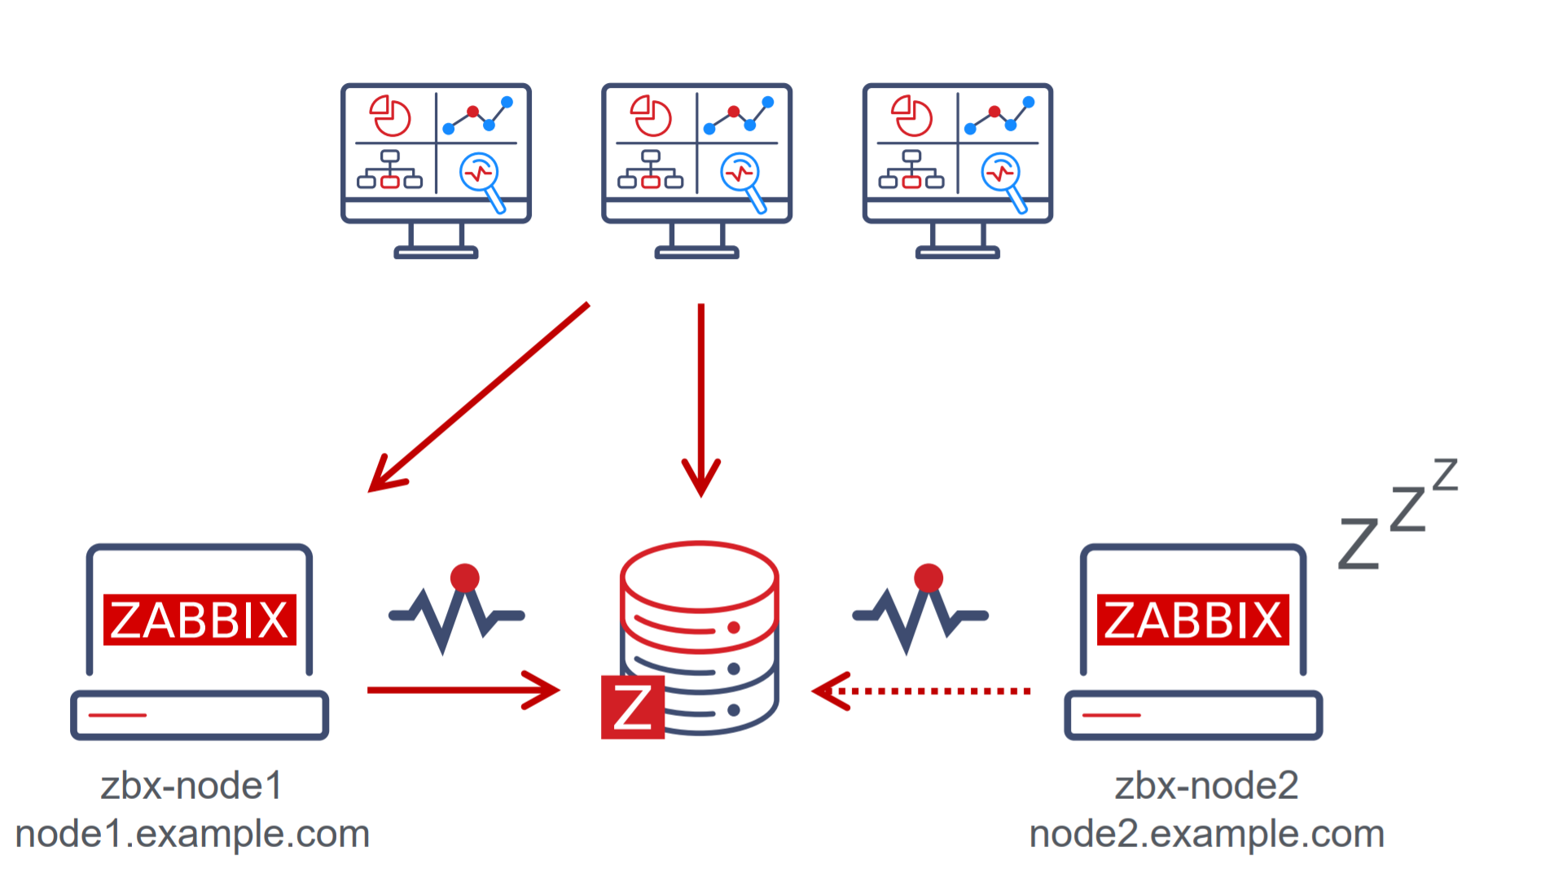
Zabbix Server high availability cluster
Each frontend node will connect to the Zabbix database, obtain the active node address and start communicating with it.

Slide 9
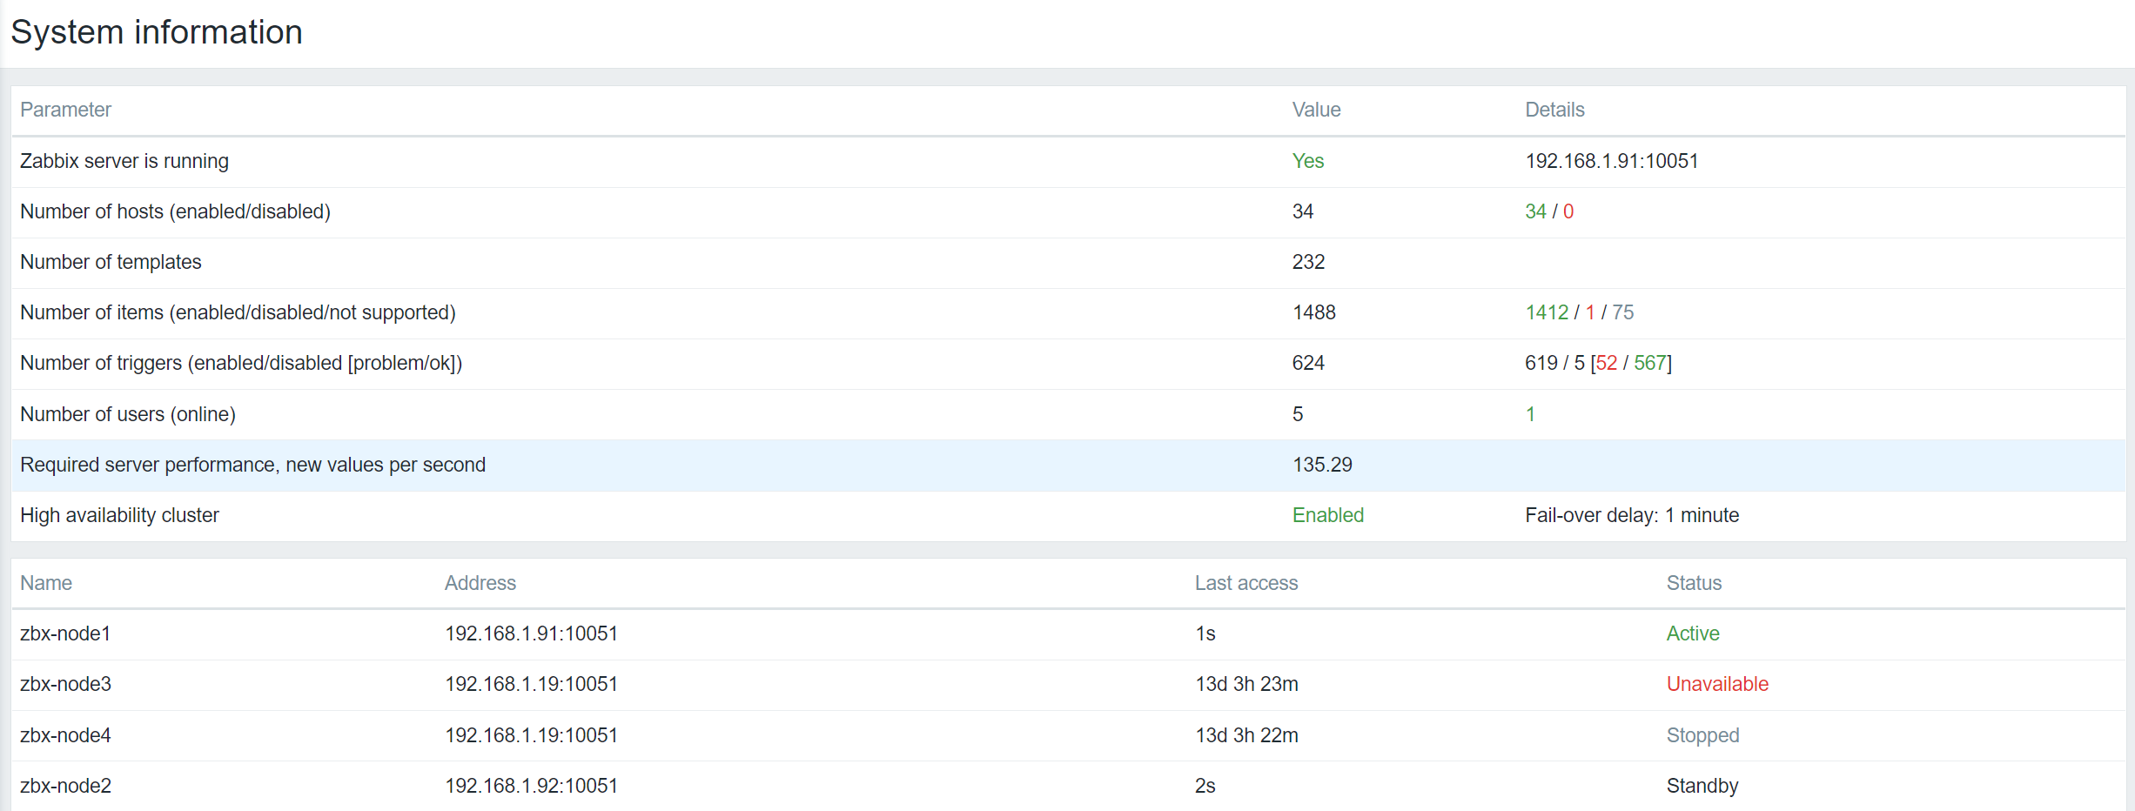
Zabbix Server high availability cluster
Zabbix Server HA cluster status can be observed in System information section or in the System information dashboard widget

Slide 10
Zabbix Server high availability cluster
Many other new HA features:
Ability to set a custom failover delay
Ability to manually remove a node from the cluster
Both active and passive agents can now communicate with HA nodes
Both active and passive proxies can now communicate with HA nodes
Cluster node LLD rule added to the Zabbix server health template
#zabbix_server -R ha_remove_node=ckyjydgop0001c1pvhaoz4o4e
Removed node "zbx-node4" with ID "ckyjydgop0001c1pvhaoz4o4e"

Slide 11
Business service monitoring
02

Slide 12
Business service monitoring
Business Service monitoring (BSM) enables Zabbix administrators to define services of varying complexity and monitor their status
Most common use cases:
Server clusters
Services that utilize load balancing
Services which consist of a complex IT stack
Systems with redundant components in place
Business service monitoring is extremely scalable with support for over 100k services.

Slide 13
Business service example
Business
User services
Internal services
Web
Helpdesk
Phones
CRM
ERP
Printing
Container engine
Phone 1
Phone 2
Printer 1
Printer 2
Node 1
Node 2
PBX
CRM server
Cluster
Switch
DB
Web server
Pod 1
Pod 2
Pod 3

Slide 14
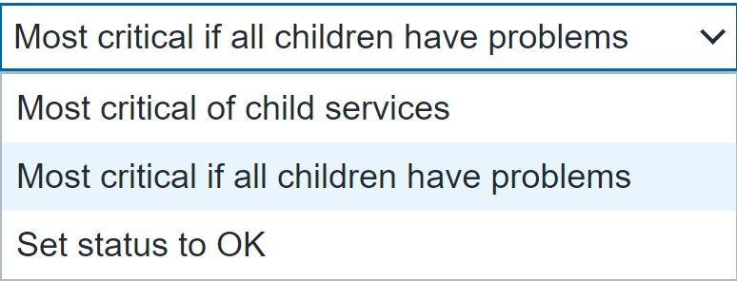
Calculating service status
There are multiple approaches to calculating service status
In case of a problem, the service state can be changed to:
The most critical problem severity based on the child service problem severities
The most critical problem severity based on the child service problem severities, only if all child services are in a problem state
The service is set to constantly be in an OK state

Slide 15
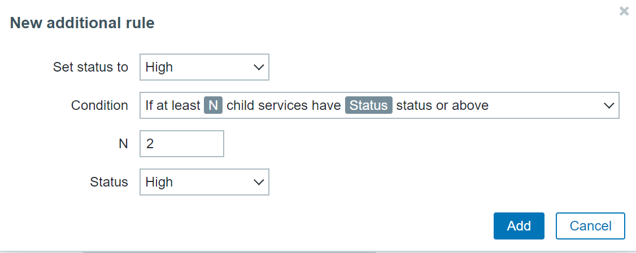
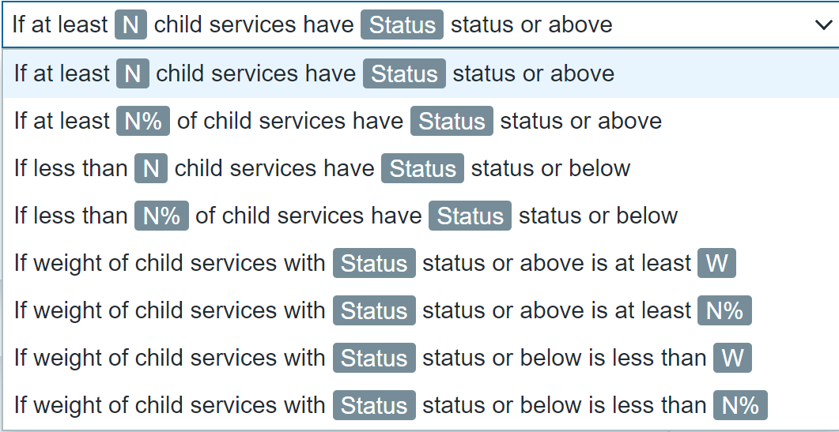
Calculating service status – additional rules

Slide 16
Business service monitoring - notes
Many other additional features and improvements:
Ability to define permissions on specific services
Business Service root cause analysis
SLA monitoring
Receive alerts and react on Business Service status change
Provide a list of root cause problems in service-based notifications and commands with {SERVICE.ROOTCAUSE}

Slide 17
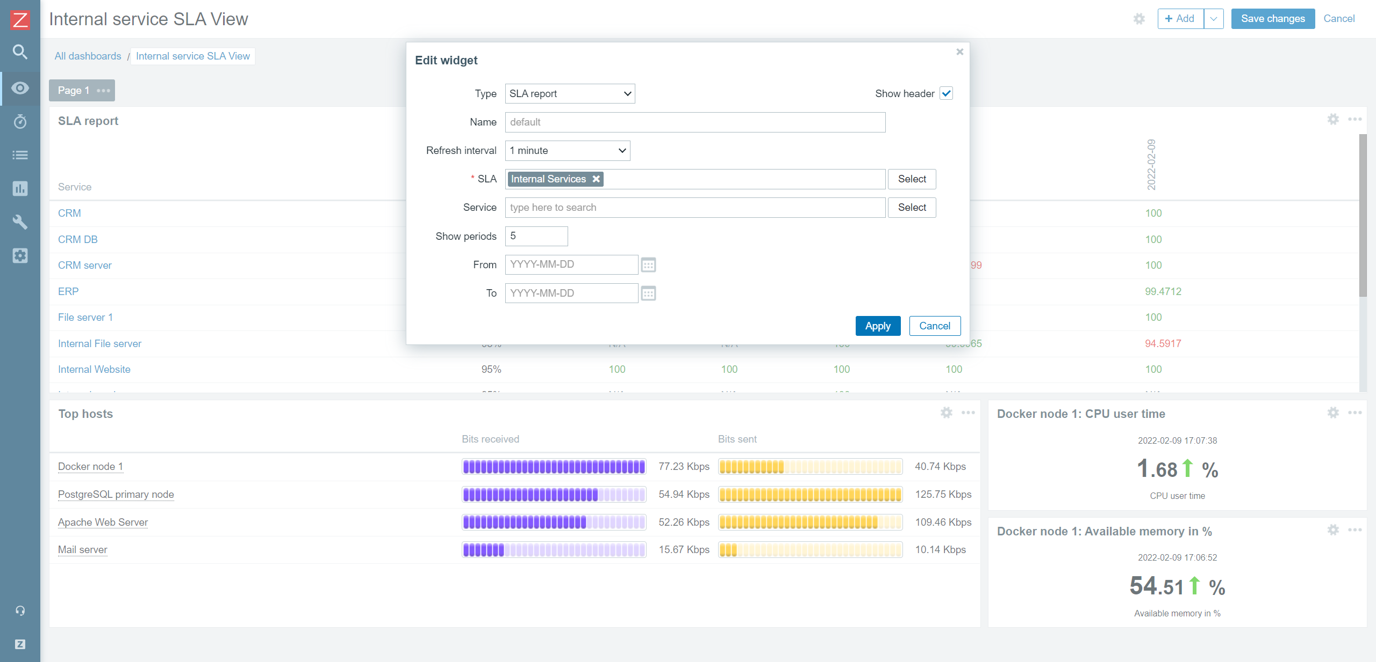
Business service monitoring - SLA

Slide 18
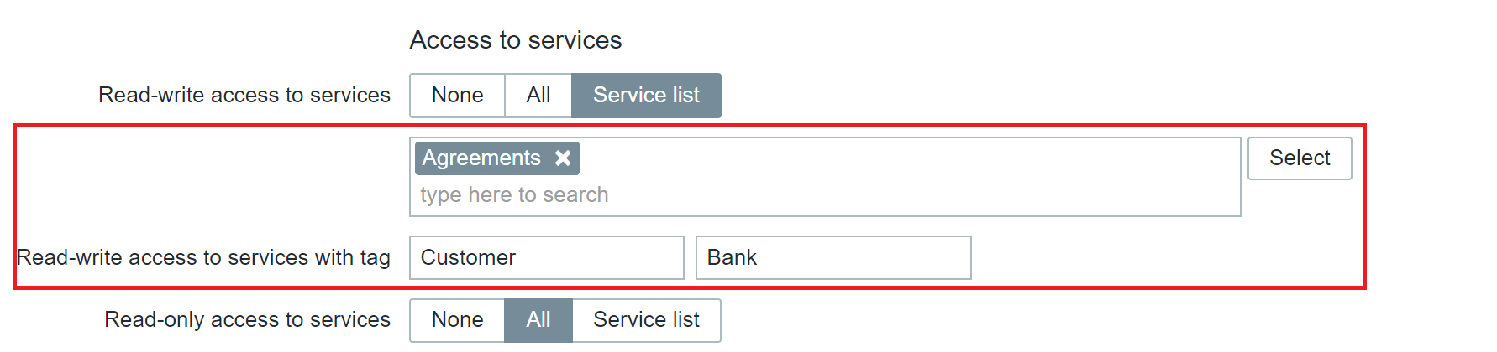
Business service monitoring - notes
Many other additional features and improvements:
Define Business Service permissions for multi-tenant environments

Slide 19
New audit log schema
03

Slide 20
New Audit log schema – technical details
Many new changes had to be made under the hood when designing the new audit log
Zabbix 6.0 LTS introduces a new database structure for the Audit log
Collision resistant IDs (CUID) will be used for ID generation to prevent audit log row locks
Audit log records will be added in bulk SQL requests
Introducing Recordset ID column. This will help users recognize which changes have been made in a particular operation

Slide 21
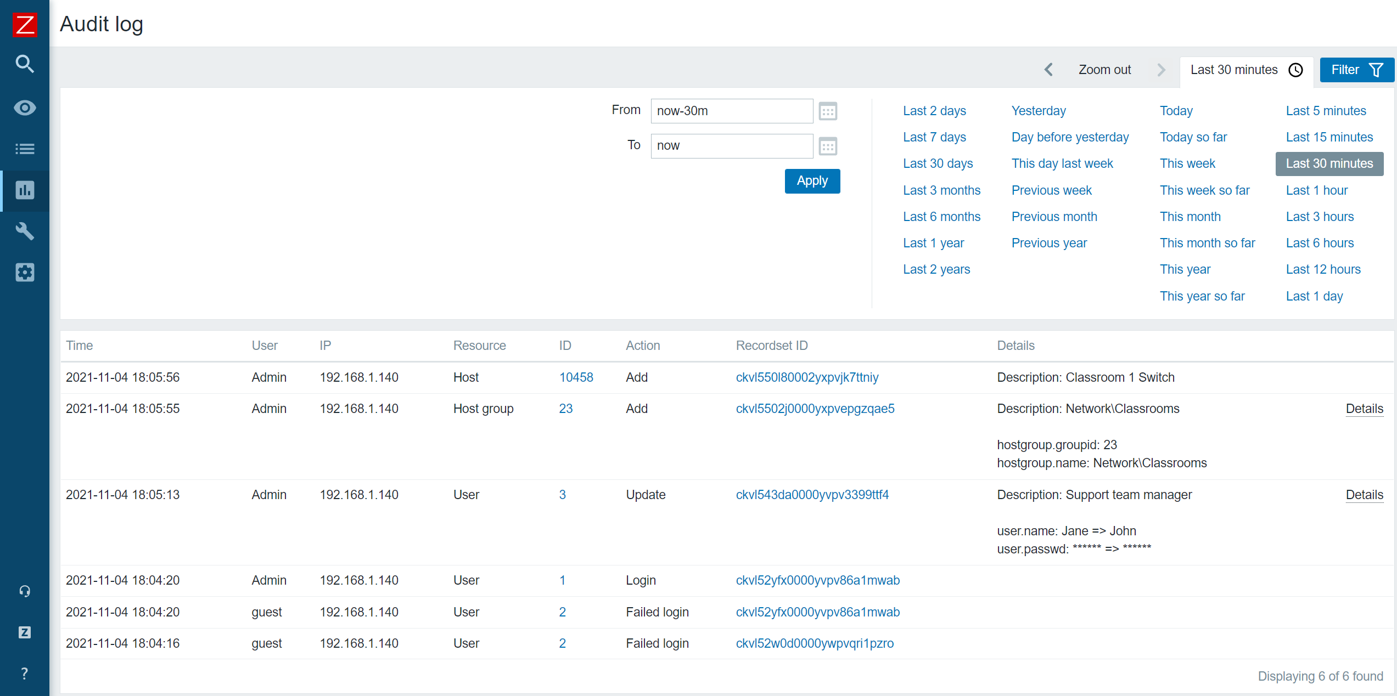
New Audit log schema – Example

Slide 22
New Audit log schema
The goal of the Zabbix 6.0 LTS audit log rework is to make a reliable and detailed audit log which would provide logging for both Frontend and Zabbix server
Detailed logging of both Zabbix frontend and Zabbix server records
Designed with minimal performance impact in mind
Accessible via Zabbix API
Implementing the new audit log schema is an ongoing effort – further improvements will be done throughout Zabbix update life-cycle

Slide 23
Machine learning
04

Slide 24
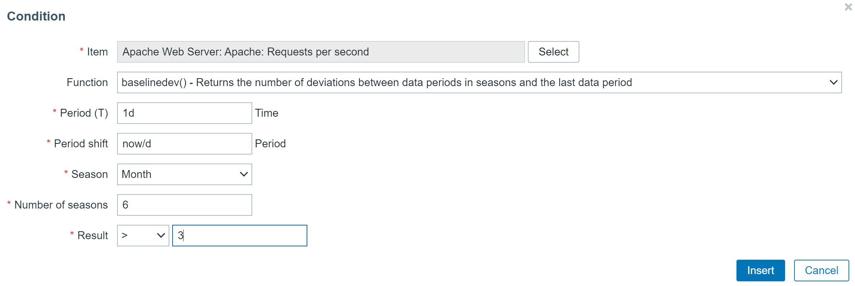
Machine learning trend functions
The new baseline monitoring and anomaly detection trend functions allow you to avoid static threshold creation and detect problems in a dynamic manner:
New trend functions – baselinewma and baselinedev allow you to calculate baselines of your metrics as well as detect deviations from it

Slide 25
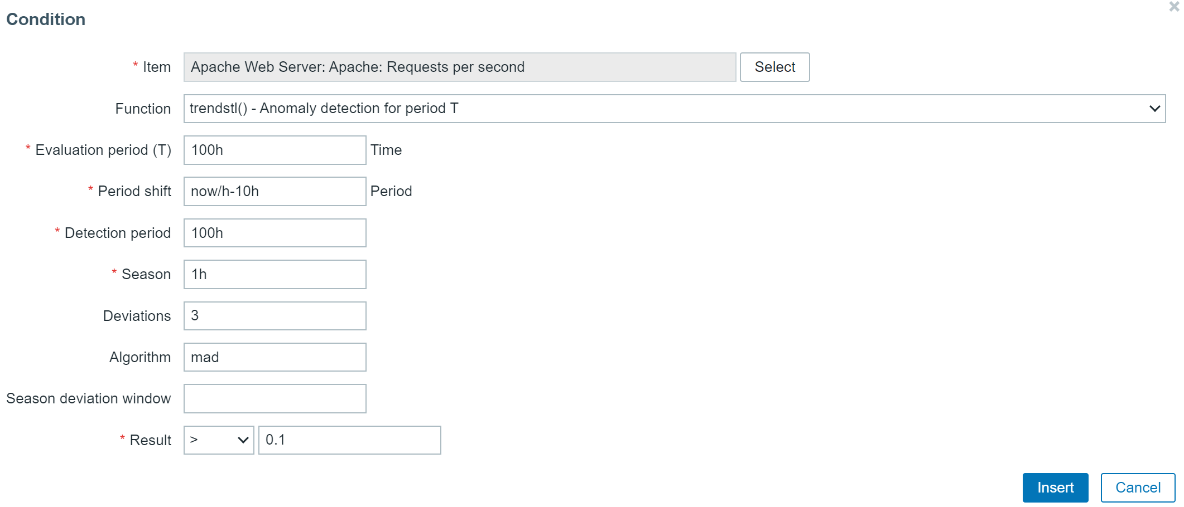
Machine learning trend functions
The new baseline monitoring and anomaly detection trend functions allow you to avoid static threshold creation and detect problems in a dynamic manner:
New trend function - trendstl, allows you to detect anomalous metric behavior
Ability to specify anomaly detection deviation algorithm and seasonality

Slide 26
Kubernetes monitoring
05

Slide 27
Kubernetes Monitoring
New templates for discovering and monitoring Kubernetes nodes and pods:
Automatic discovery of Kubernetes nodes and pods
Discover and monitor node capacity, information, request and other metrics
Discover and monitor pod condition metrics, status and uptime
Metrics are collected agentlessly by communicating with the Kubernetes API

Slide 28
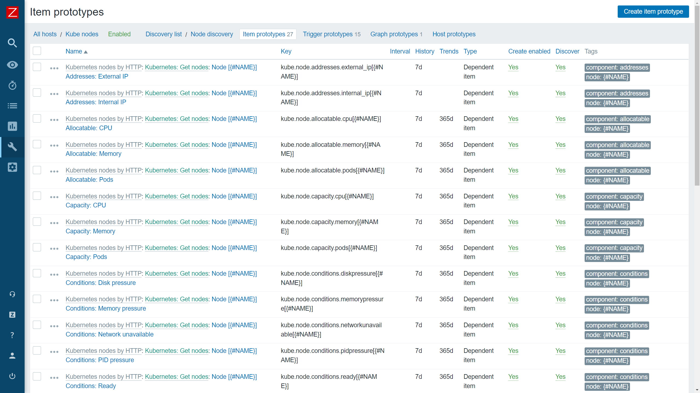
Kubernetes Monitoring

Slide 29
Kubernetes Monitoring
New templates for discovering and monitoring Kubernetes components such as:
API servers
Kubelet
Controller manager
Replicasets
Scheduler
And more
Metrics are collected agentlessly by communicating with the Kubernetes API

Slide 30
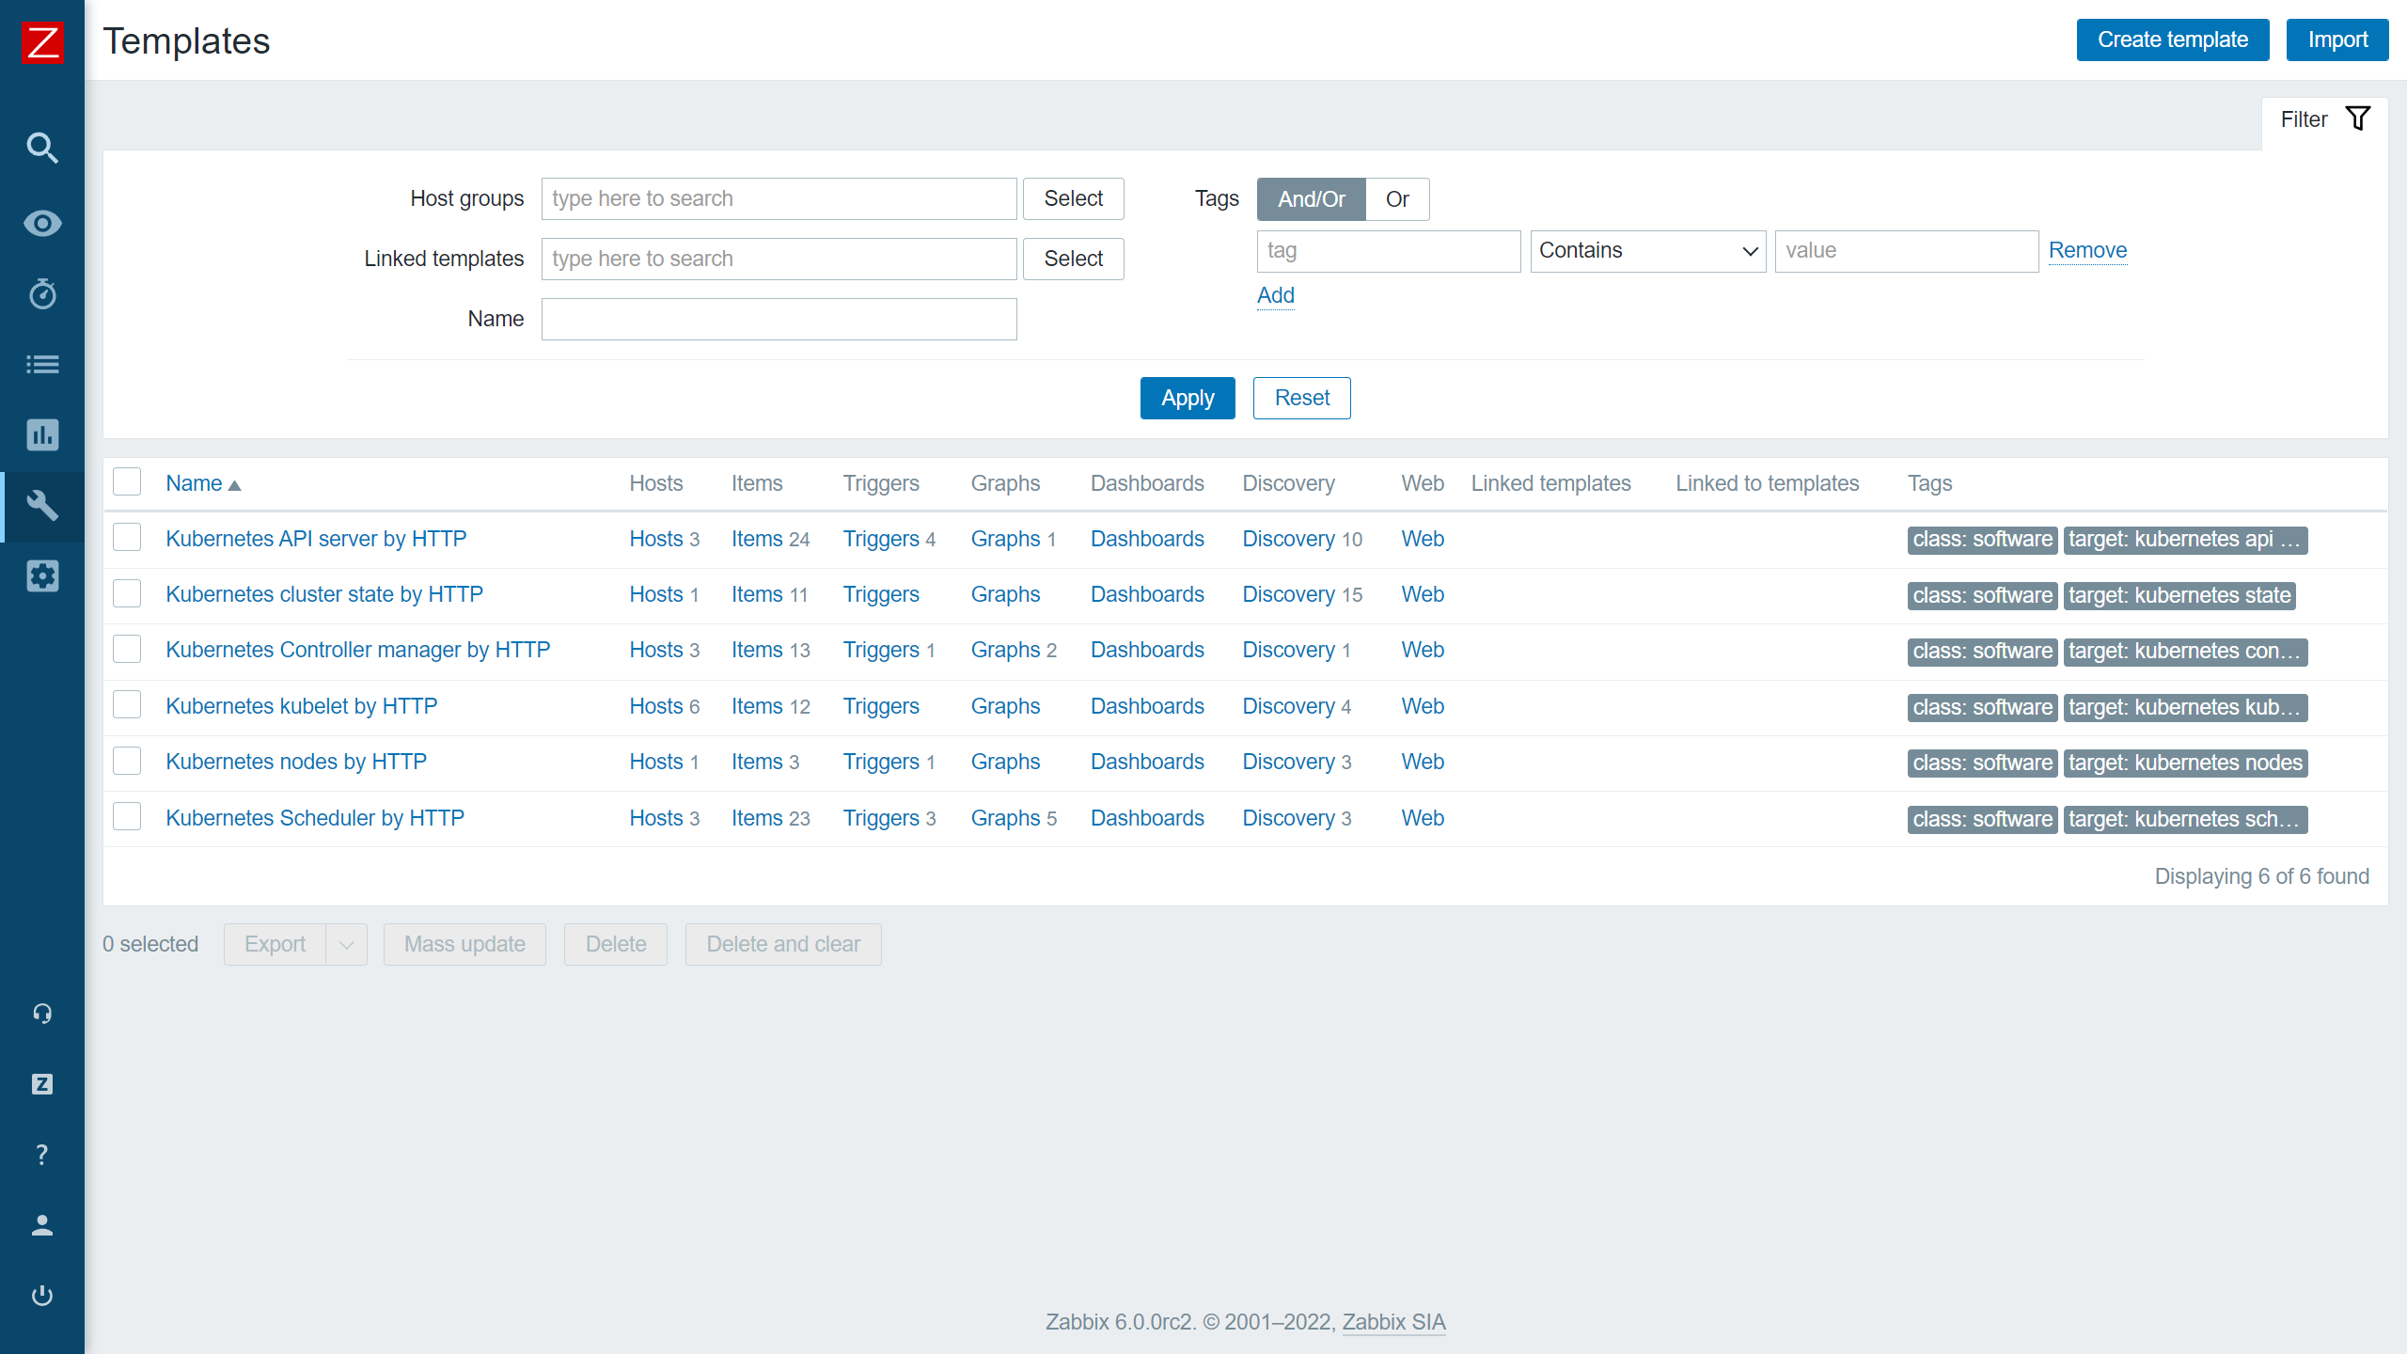
Kubernetes Monitoring

Slide 31
New ways to visualize your data
06

Slide 32
New Dashboard widgets
The new widgets introduced in Zabbix 6.0 grant you many new ways to display information about your environment:
New widgets such as Top hosts, Single item, Geomaps
The SLA report widget displays the current SLA for services filtered by service tags
All new widgets are highly customizable

Slide 33
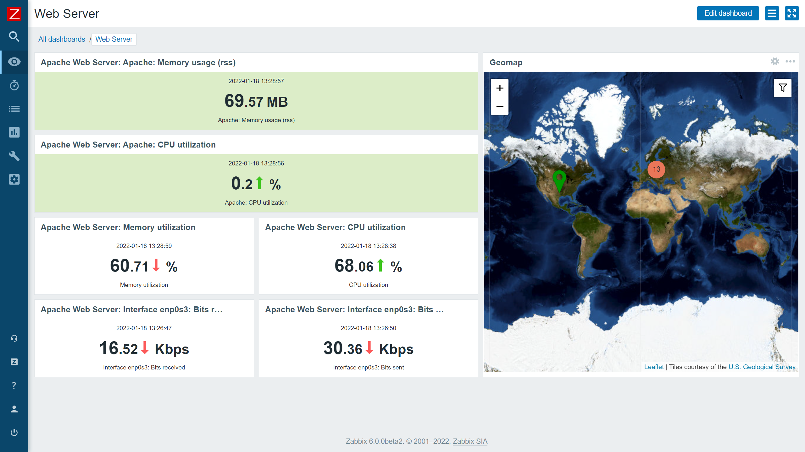
New Dashboard widgets
The single item widget allows you to display values for a single metric

Slide 34
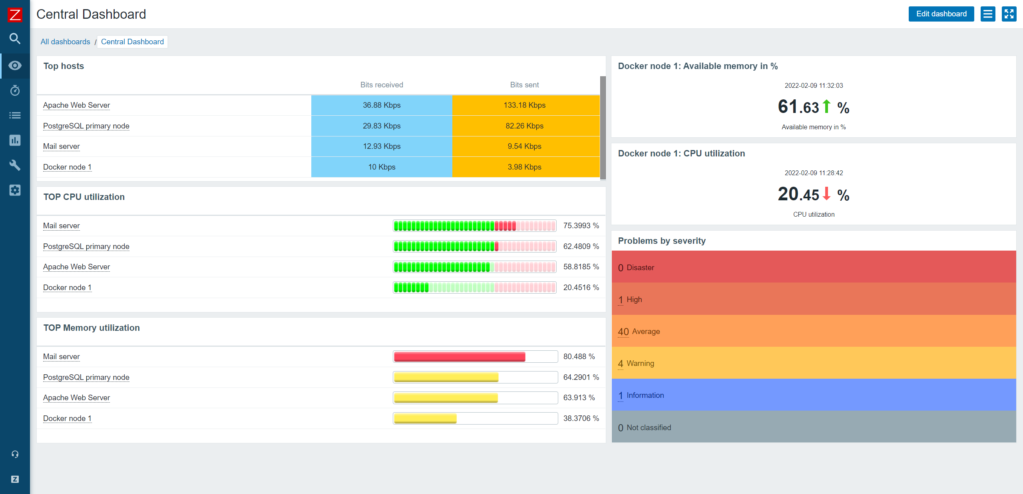
New Dashboard widgets
The Top hosts widget can be used to display a list of Top N or Bottom N hosts sorted by an item value

Slide 35
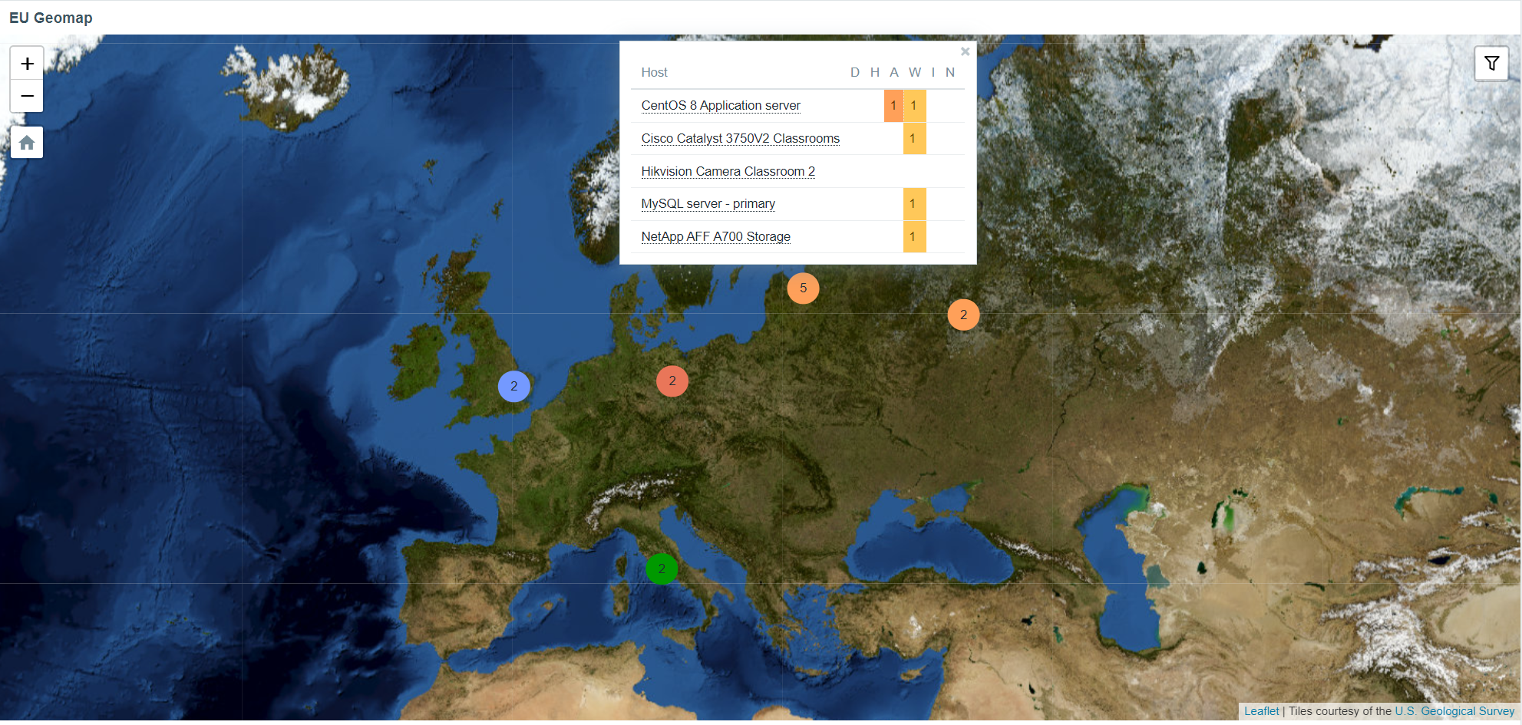
Introducing - Geomaps
Now Zabbix users have the ability to see their host location on a geographical map in their dashboard:
Multiple Geomap providers, such as: OpenStreetMap, OpenTopoMap, USGS US Topo and others

Slide 36
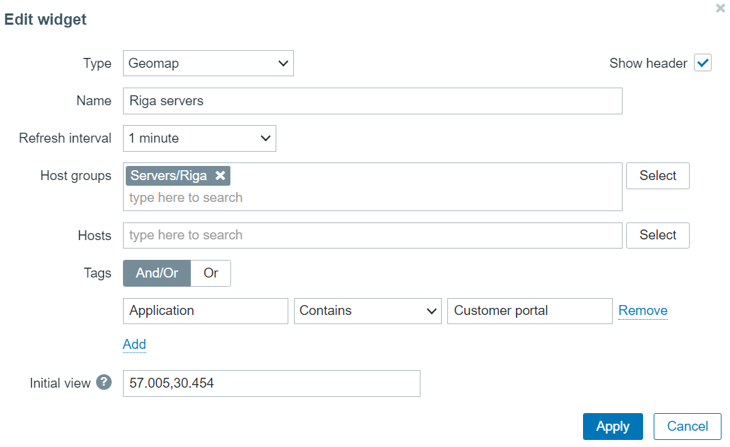
Introducing - Geomaps
Now Zabbix users have the ability to see their host location on a geographical map in their dashboard:
The host coordinates are provided in the host inventory fields
Filter by host groups and tags

Slide 37
Zabbix agent – improvements and new items
07

Slide 38
New Zabbix agent items
Multiple new items have been added for both Zabbix Agent And Zabbix Agent2. These items give you the ability to:
Obtain additional file information such as file owner and file permissions
Collect agent host metadata as a metric
Collect Zabbix agent variant (agent or agent2) as a metric
New system.hostname parameter for returning the short hostname
Count matching TCP/UDP sockets
You can now natively monitor your SSL/TLS certificates with a new Zabbix Agent2 item. The item can be used to validate a TLS/SSL certificate and provide you additional certificate details.

Slide 39
Zabbix agent improvements
Zabbix agent and Zabbix agent2 have received significant improvements:
Zabbix agent2 now supports loading stand-alone plugins without having to recompile Zabbix agent2.
It is now possible to reload user parameters without restarting the Zabbix agent
Support of persistent log monitoring state file to prevent log file re-reads under specific scenarios
The new optional parameter persistent_dir specifies a directory for storing this state of log[], log.count[], logrt[] or logrt.count[] item in a file.
Each Zabbix agent 2 plugin now has a separate configuration file

Slide 40
Custom zabbix password complexity requirements
08

Slide 41
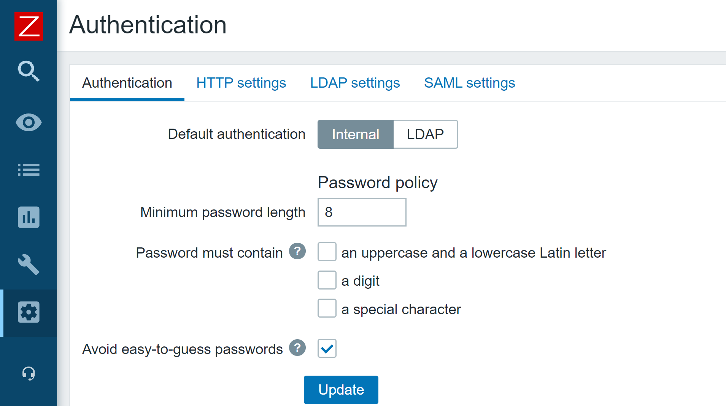
zabbix password complexity requirements
Zabbix Super admins now have the ability to define the password complexity requirements. Now you can:
Set the minimum password length
Define password character requirements
Mitigate the risk of a dictionary attack by prohibiting the usage of the most common password strings.

Slide 42
Ui/ux improvements
09

Slide 43
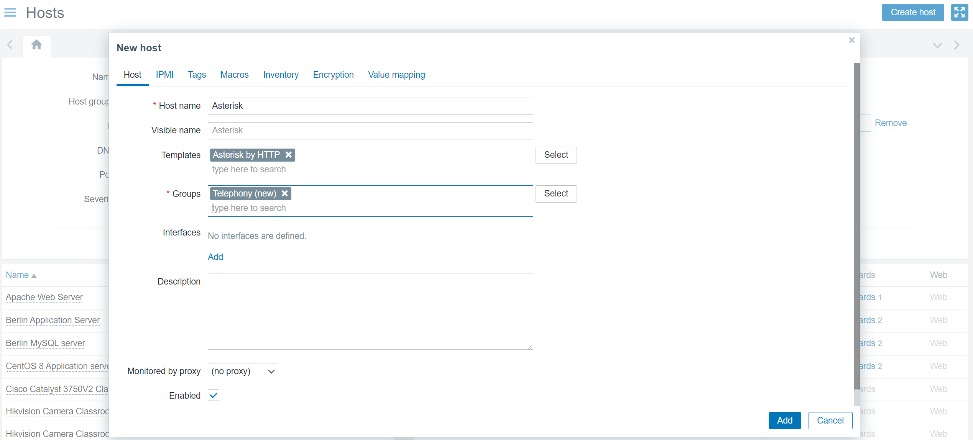
UI/UX Improvements
Multiple UI/UX improvements have been added, based on the community feedback:
Create hosts directly from 'Monitoring' - 'Hosts'
Templates can now be assigned in the main Host creation tab

Slide 44
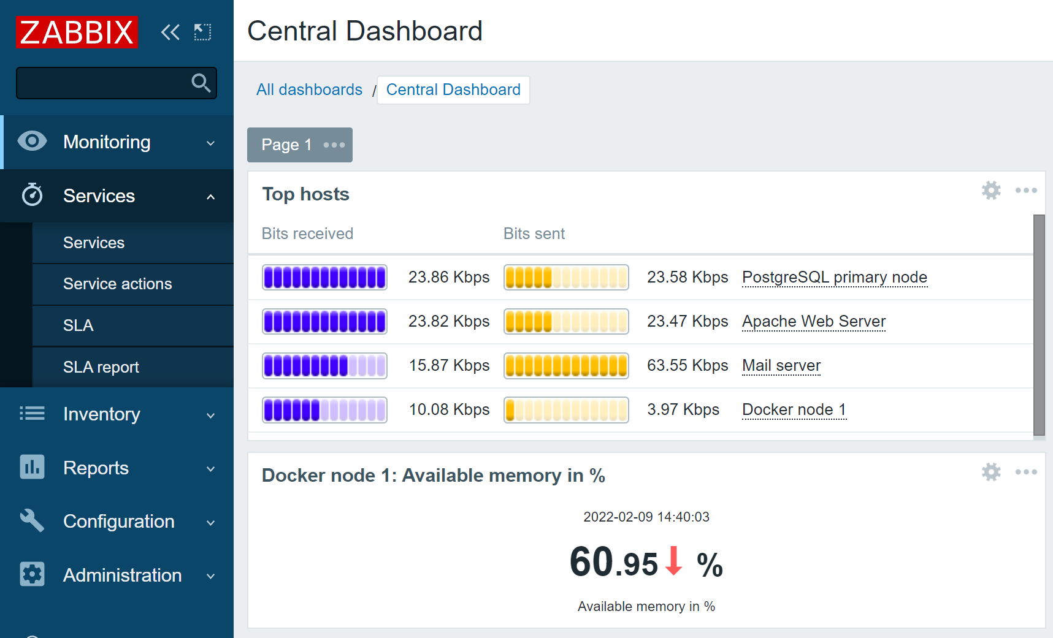
UI/UX Improvements – Services section
New Services sections for business service, SLA, SLA report and service action configuration
The default type of information for items will now be selected automatically

Slide 45
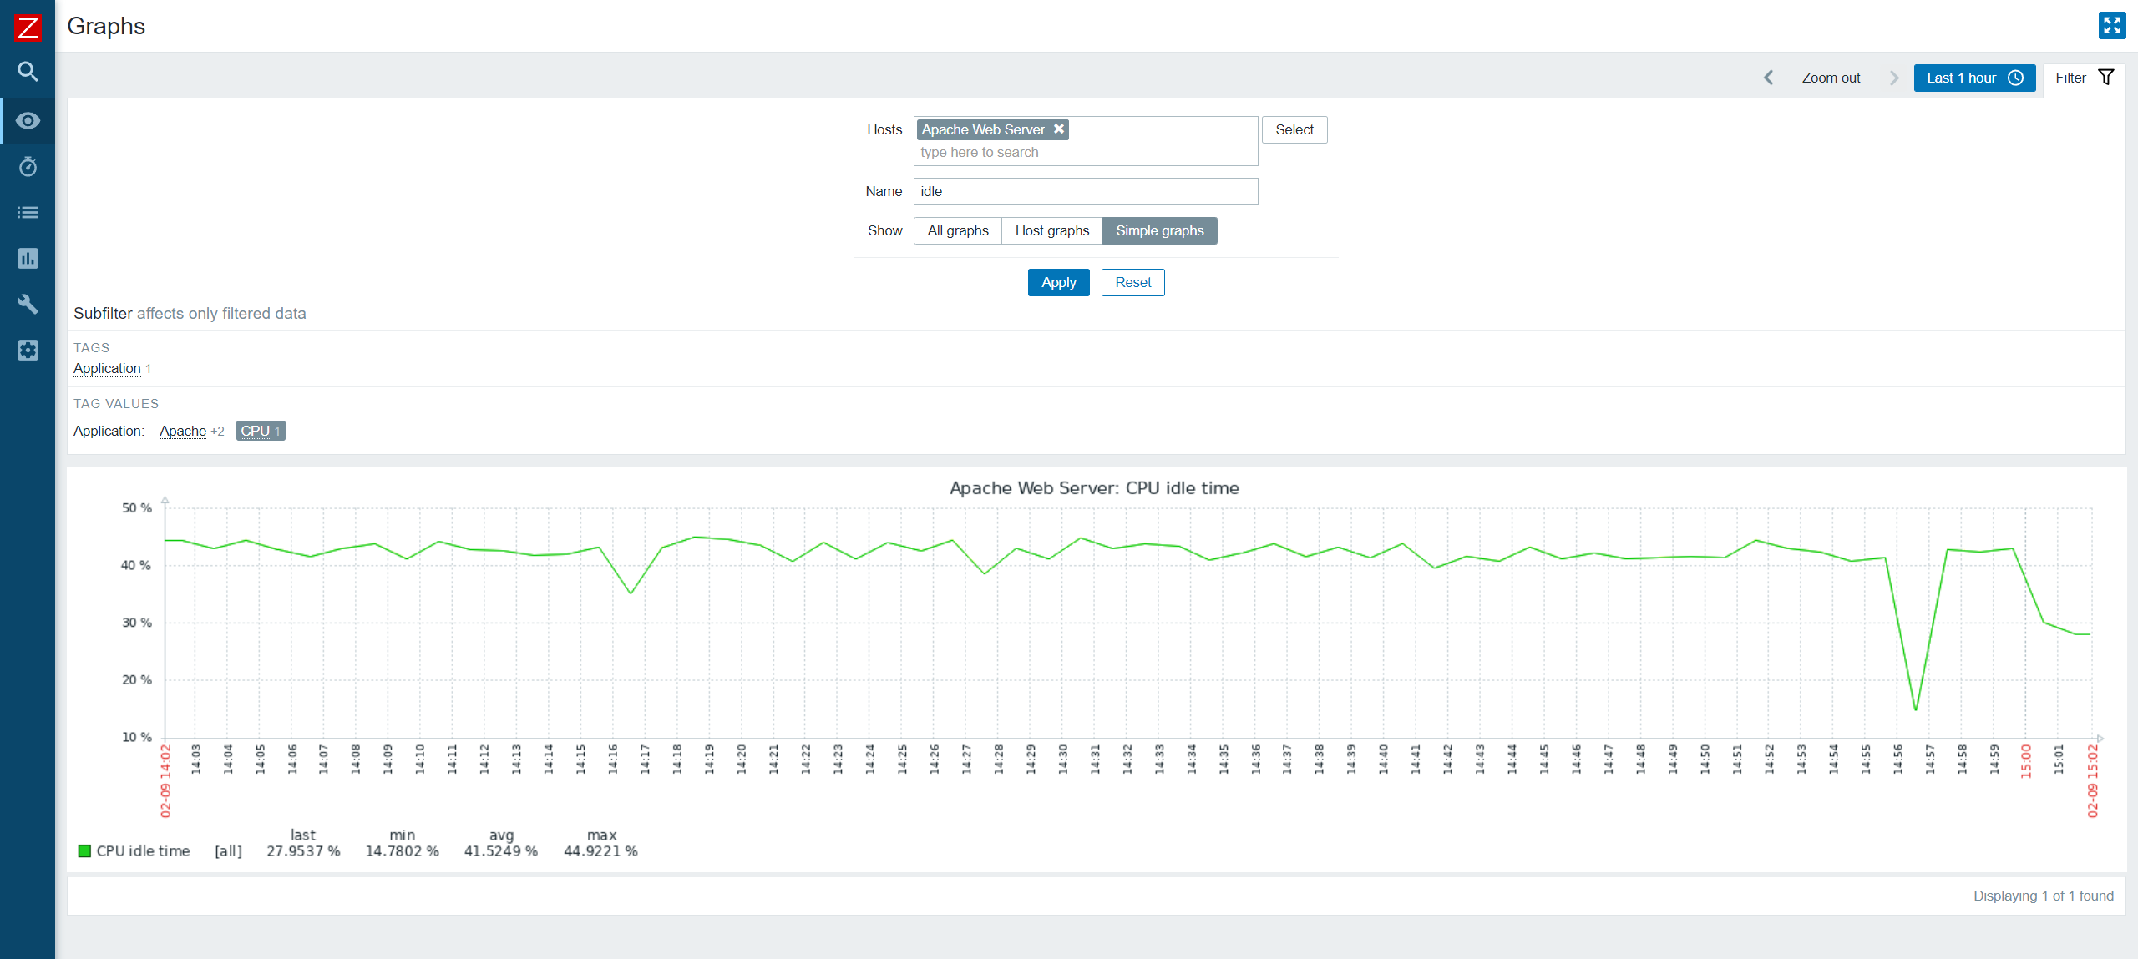
UI/UX Improvements - Graphs
Monitoring – Hosts – Graphs section has been redesigned for better UX and performance

Slide 46
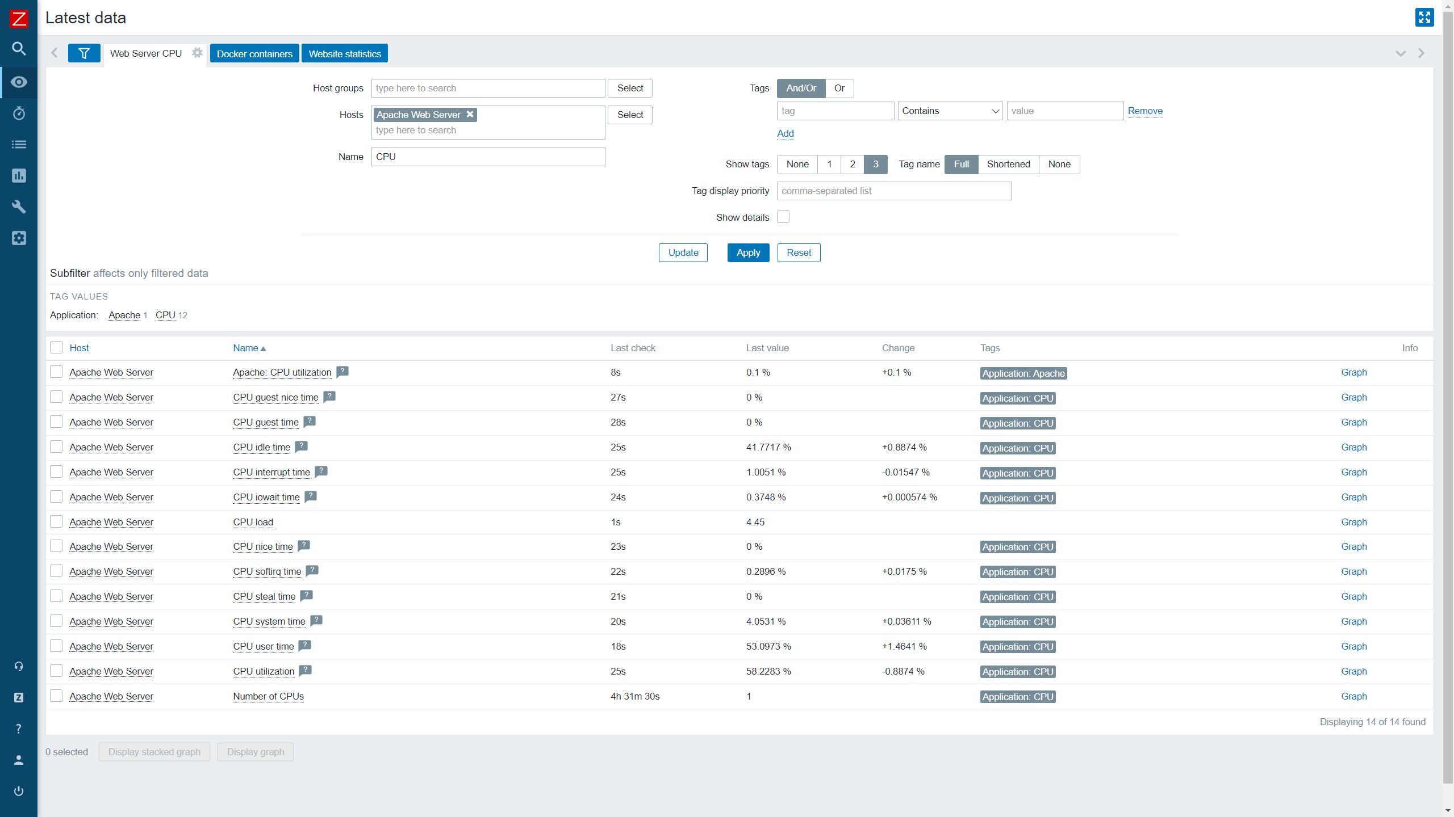
UI/UX Improvements – Latest data
Added the ability to save named filters and use subfilters in Latest data

Slide 47
New templates and integrations
10

Slide 48
New Templates and integrations
Zabbix 6.0 comes pre-packaged with many new templates for the most popular vendors:
Zabbix 6.0 also brings a new GitHub webhook integration which allows you to generate GitHub issues based on Zabbix events!
f5 BIG-IP
Cisco ASAv
HPE ProLiant servers
Cloudflare
InfluxDB
Travis CI
Dell PowerEdge
pfSense
Kubernetes
Mikrotik
Nginx Plus
VMware SD-WAN VeloCloud
GridGain
Systemd

Slide 49
Updates to Templates and integrations
Zabbix 6.0 also brings improvements to the existing set of templates and integrations:
All of the official Zabbix templates are now stand-alone and do not require importing additional template dependencies
HA node discovery and monitoring for Zabbix server health/Remote Zabbix server health
Updated Zabbix proxy templates according to the latest guidelines
Added CPU usage metrics to Docker template
Added new tags to all official templates
Fixed item value maps for VMware templates

Slide 50
Other changes and improvements
11

Slide 51
Vmware monitoring improvements
Multiple improvements have been made to existing VMware items. Support for new items has also been added:
Improved data collection for VMware performance counters that return percentage values
Collect VMware hypervisor HW vendor state sensors with vmware.hv.sensors.get
Collect VMware hypervisor maintenance status with vmware.hv.maintenance
Imporved the behavior of the skip parmeter for the vmware.eventlog key

Slide 52
New History functions
Multiple new history functions have been added:
Detect continuous increase or decrease of values with new monotonic history functions – monodec(), monoinc()
Count the number of changes in adjacent values with changecount()

Slide 53
New Aggregate functions
Multiple new general use aggregate functions have been added:
Return the total number of values in an array returned by a foreach function with count()
Return the total number of currently enabled items (as an integer) that match filter criteria with item_count
Return the total number of currently enabled items (as an array) that match filter criteria with exists_foreach

Slide 54
New prometheus functions
Multiple new aggregate and history functions have been added for Prometheus monitoring:
History functions:
Calculate rates for Prometheus monotonic counters with rate()
Aggregate functions:
Calculate percentile values from the buckets of Prometheus histograms with bucket_percentile()
Calcualte quantile from values from buckets of Prometheus histograms with histogram_quantile()
Return pairs of bucket upper bound and rate value for use in histogram_quantile() with bucket_rate_foreach()

Slide 55
New Macros
New macros are now supported for trigger expression and internal action debugging:
{TRIGGER.EXPRESSION.EXPLAIN}, {TRIGGER.EXPRESSION.RECOVERY.EXPLAIN} - resolve to a partially evaluated trigger or recovery expression, where only item-based functions are applied;
{FUNCTION.VALUE<1-9>}, {FUNCTION.RECOVERY.VALUE<1-9>} - resolve to the results of the Nth item-based function at the time of the event.
Display a reason why an item became unsupported with {ITEM.STATE.ERROR}
Display a reason why an LLD rule became unsupported with {LLDRULE.STATE.ERROR}
Display a reason why a trigger became unknown with {TRIGGER.STATE.ERROR}

Slide 56
CLI tool and runtime command changes
New features have been added to the existing command line tools:
Added support for Timeout settings for Zabbix command-line tools
Zabbix server and proxy runtime commands are now sent via socket instead of Unix signals
Results of the command execution are now printed to the console
Runtime control options are now supported on BSD-based systems

Slide 57
Performance improvements
New features and improvements related to Zabbix performance:
A new configuration parameter StartODBCPollers has been added to Zabbix server and proxy configuration files
Processing ODBC checks has been moved from regular poller processes to separate server/proxy processes ODBC pollers
Improved performance of template linking on Zabbix Server
Improved performance for Prometheus pattern preprocessing

Slide 58
Performance improvements
New features and improvements related to Zabbix performance:
Improved protocol to support Zabbix proxy configuration cache of size up to 16 GB
Improved Zabbix proxy performance and memory usage by freeing uncompressed data as fast as possible and compressing before connection
Improved Zabbix agent2 performance by using functions introduced in Go 1.16
Added primary key support for History tables – improved performance and reduced DB size.

Slide 59
Other Changes and improvements
Many other improvements have been added in Zabbix 6.0 LTS:
Added utf8mb4 as a supported MySQL character set and collation
Added the support of additional HTTP methods for webhooks
Support for two new Prometheus preprocessing label matching operators != and !~
Calculated items now support not only numeric, but also text, log, and character types of information.
New API method – history.clear can be used to clear history for items and web scenarios
Added option to opt-out of Escalation cancelled messages

Slide 60
Questions?
www.zabbix.com

Slide 61


Slide 62
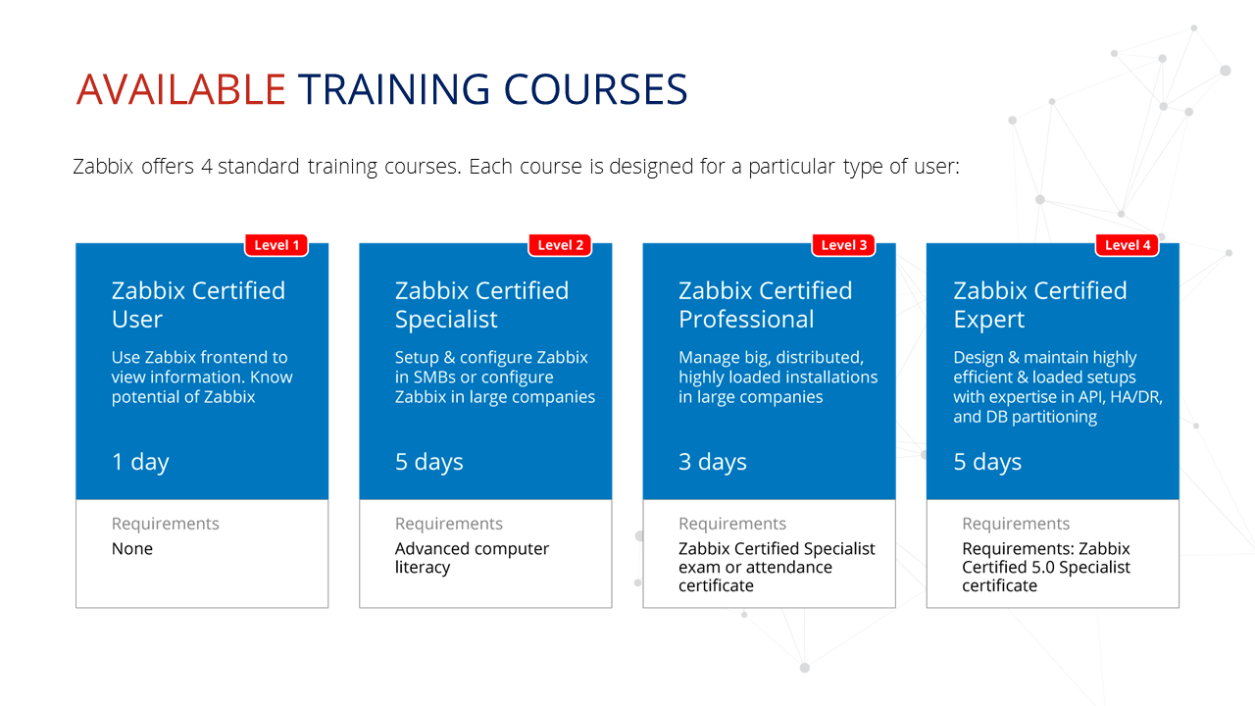

Slide 63
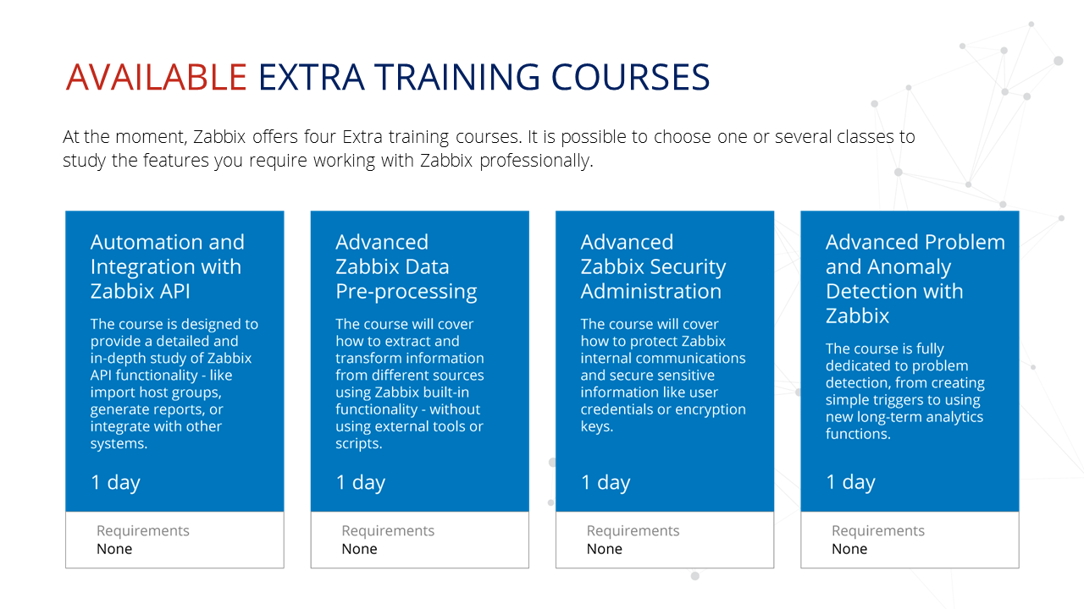

Slide 64
Thank you
www.zabbix.com

